Slide 1
Fire Safety Presentation 2019
222 Berkeley & 500 Boylston
Boston, MA
Notes:
Greetings & welcome to the 222 Berkeley & 500 Boylston Fire Safety Presentation
Introduce myself

Slide 2
AGENDA
1
Fire Classes & Prevention
Building Systems – Fire & Security
2
Responsibilities
3
Emergency Procedures – Fire Alarm
4
Emergency Procedures – Other
5
S FAQ
6
S Next Steps
7
Notes:
For the next hour we will be going through a basic understanding of what you need to know
There will be a Q&A session at the end but if you feel like you have a burning question please feel free to ask

Slide 3
#1 - Fire Classes & Prevention

Slide 4
Anatomy of a Fire
“A rapid oxidation-reduction reaction accompanied by the evolution of heat and light”
Oxygen
Heat
Fuel
Notes:
Really quick explanation of a fire that we all learned in grade 5
In order to produce some sort of flame, you require three items. Oxygen, heat, and fuel. Take away any of these three elements and the fire is extinguished immediately

Slide 5
Fire Classes
Class A – Ordinary combustibles or fibrous material, such as wood, paper, cloth, rubber, and some plastics.
Class B – Flammable or combustible liquids such as gasoline, kerosene, paint, paint thinners and propane
Class C – Energized electrical equipment, such as appliances, switches, panel boxes and power tools.
Notes:
Examples of fire classes

Slide 6
Fire Prevention
No smoking in the building or in service areas
Do not use damaged or prohibited electrical appliances (including space heaters)
Store and dispose of hazardous and flammable materials appropriately
Do not hang anything from sprinklers or detectors
Report any potential hazards to your Fire Warden or Emergency Response team immediately

Slide 7
#2 – Building Systems: Fire & Security

Slide 8
Building Facts – 222 Berkeley
22 Floors, 290 Feet
12 Elevators: 5 high rise, 3 low rise, 2 garage, 1 jump and 1 freight
Complete fire suppression, fire alarm and smoke evacuation systems
3 Stairwells – Stairwell pressurization systems

Slide 9
Building Facts – 500 Boylston
25 Floors, 315 Feet
19 Elevators: 4 high rise, 5 mid rise, 4 low rise, 2 garage, 3 jump and 1 freight
Complete fire suppression, fire alarm and smoke evacuation systems
3 Stairwells – Stairwell pressurization systems

Slide 10
Fire Alarm System
What it sounds like:
A pre-alert message, which is a dinging tone followed by a message repeated two times.
If you’re on the floor of incidence, directly above or directly below, you will hear the evacuation tone which is a series of beeps. When you hear this tone, evacuate!
When the fire alarm is initiated:
A pre-alert message will sound
The evacuation tone and strobe lights are activated on the floor of incident, directly above and directly below
If a sprinkler system flow detector was the initiating device, you may notice one or more of the ceiling mounted sprinkler heads discharging water.
Exhaust fans start and smoke dampers open on the floor of incident, evacuating smoke and putting the fire floor into negative pressure to prevent the fire and smoke from spreading.

Slide 11
Fire Alarm - Stage I and Stage II
Any floor that initiates an alarm immediately goes into a Stage II (evacuation).
The floors above and below will also alarm and proceed to a Stage II.
The rest of the complex will go into a Stage I (alert).
Notes:
Stage 1 = Listening and Preparing
Stage 2 = Action and Evacuation

Slide 12
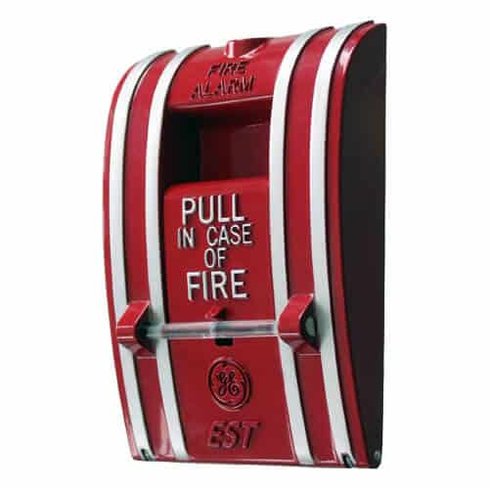
Manual Fire Alarm Activations (Pull Station)
Immediately activates a Stage II Alarm on three floors:
Activated Floor
Floor Above
Floor Below
Located on each stairwell entrance as well as all retail and lobby exits
Should be activated where smoke or a fire is observed

Slide 13
Fire Alarm System Devices
Smoke Detectors
Speaker Strobes
Exit Signs

Slide 14
Sprinkler Systems
Concealed Sprinkler Head
Liquid expands

Slide 15
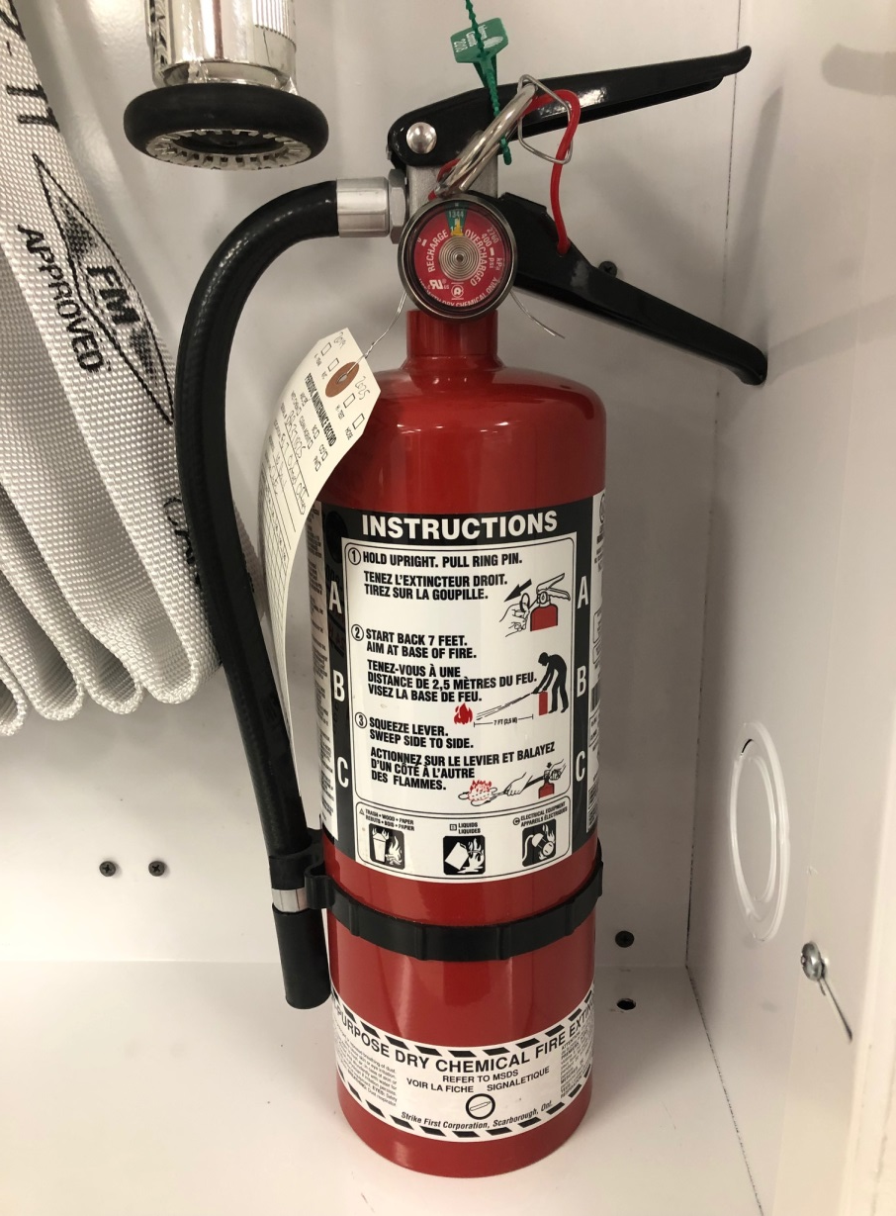
Fire Extinguishers
5 Lbs (ABC) Dry Chemical
6 Year Lifespan
Checked Monthly
Verified Annually
Pull
Aim
Squeeze
Sweep
7 Feet back with Exit behind you

Slide 16
#3 - Responsibilities
Notes:
Main responsibilities for the landlord, fire warden, PRA, and all tenants

Slide 17
Responsibilities - Oxford Properties
Ensures that checks, tests and inspections, as required by local code, are completed on schedule and that records are retained.
Ensures that all tenants have the appropriate fire safety information for their own safety and security.
Ensures that the established Chain of Command principle is implemented by the Oxford Person in Charge (OPIC) to allow for a single point of contact during any event.
Notes:
Checking and maintaining all base building security and fire life safety systems as per local code

Slide 18
Emergency Response Team Roles (ERT) (Tenant)
Floor Warden/Suite Monitors
Searchers
Persons Requiring Assistance (PRA)
PRA Assistants
Alternates

Slide 19
Responsibilities - Floor Warden/Suite Monitors (Tenant)
Floor Warden: appointed by a tenant of a full floor; Suite Monitors: appointed by a tenant on a multi-tenanted floor
Assists in fire prevention by noting and reporting to property management where fire hazards or unsafe conditions exist.
Maintains a list of the Emergency Response Team (ERT) and the Persons Requiring Assistance (PRA). All items should be communicated to Oxford.
Designates an area at least 300 feet from the property as the company muster point. Relays this information to Oxford.
Notes:
There may be a deficient pull station missing the glass rod, tripping hazard in the stairwell, etc
There should be a list sent to Oxford Properties updated at least twice a year indicating any change in the Fire wardens or PRA form. Oxford does not need to know the specifics of the PRA.
During an alert, or an alarm (more info on that later), ensure that a calm and safe evacuation is taking place on the floor. Make note of any individuals still on the floor

Slide 20
Responsibilities - Floor Warden/Suite Monitors (Tenant) cont’d
5. Organizes and directs the ERT for the assigned floor/suite and common areas on the floor.
6. Wears appropriate emergency identification.
7. Ensures that all public areas of their assigned floor/suite are searched and evacuated.
8. Keeps Oxford informed of evacuation status.
9. Keeps Oxford informed of absences of ERT members responsible for public areas and any PRAs not evacuated.

Slide 21
Searchers (Tenant)
Appointed for each floor and each suite.
Searches all rooms in their suite and common areas on their floor to ensure everyone has evacuated.
Uses Post-It notes to identify that areas or offices are vacated.
Informs the Floor Warden/Suite Monitor when assigned area is fully evacuated.

Slide 22
Responsibilities – Persons Requiring Assistance (PRA)
Ensure your information is provided to the appropriate Floor Wardens.
Ensure that your PRA Assistants are aware of your situation and your location.
Proceed to the nearest stairwell door and wait within premise until the entire floor has been evacuated.
After the entire floor has been evacuated, shelter in place in the nearest stairwell.

Slide 23
PRA Assistants (Tenant)
Appointed by each tenant on each floor. It is recommended to have two PRA (Persons Requiring Assistance) Assistants for each PRA.
Aids PRAs and assures their safe evacuation by remaining with them until the fire department locates them.
If there is evidence of fire, PRAs should be moved into a designated area on the floor once the floor is clear of evacuating personnel.
Once the entire floor has been evacuated, PRAs and their assistants should shelter in place in the nearest stairwell.

Slide 24
Alternates (Tenant)
Sufficient alternates for each ERT position must be assigned so that principal or alternate is in the building at all times during normal business hours to provide leadership under the evacuation plan.
Coverage during vacations, sick leave, etc must be taken into account.

Slide 25
Communication Flow
Searchers
Floor
Warden/
Suite
Monitors
OPIC
PRA Assistants

Slide 26
Responsibilities - All Tenants
Be able to locate and identify:
Evacuation corridors
Exit stairwells
Fire extinguishers
Pull Stations
Relocation areas
Listen and follow instructions as indicated within the automated messages. If requested to evacuate, proceed to the nearest stairwell.
Don’t bring any belongings that could fall and create a slipping hazard.
Walk calmly and orderly down the stairwell, staying on the right hand side. Upon exiting the building, proceed to your designated muster point.

Slide 27
#4 – Emergency Procedures – Fire Alarm

Slide 28
Stage 1 (Alert)
Don’t Panic & Stay Calm
Prepare to Evacuate
Start saving work and change footwear if necessary
Wait for further instructions from the fire alarm system
Listen to instructions or reminders from Fire Warden
222 Berkeley
500 Boylston

Slide 29
Stage 2 (Alarm)
Proceed calmly to nearest Stairwell. Do not use elevators.
Do not bring any beverages or carry any items that could become a tripping hazard within stairwell.
Before opening any door, feel the door handle and the door itself for heat. If hot, proceed to the next stairwell.
Proceed down the stairwell, single file and staying to the right and evacuate to the exterior of the property. Listen to all instructions by any Oxford, Security or emergency responder.
Congregate at your muster point and check with Fire Warden.
Fire Warden check in with OPIC at designated Oxford meeting spot (Trinity Church facing the library).

Slide 30
Person Requiring Assistance (PRA)
If the floor is evacuating (Stage II), proceed to the nearest stairwell and wait until the rest of the floor has fully evacuated.
Ensure the Fire Warden is aware of your location
If smoke or a fire becomes threatening, move to the interior of the stairwell and close the door behind you

Slide 31
Stage II (Alarm) - EMERGENCY
Stairwell:
If smoke is encountered in a stairwell, exit on the closest floor and cross over to another stairwell.
Floor:
If a stairwell cannot be accessed from your floor, return to a safe suite or boardroom.
Close (do not lock) all doors
Seal cracks where smoke can enter by using any material possible
CONSIDER AN EMERGENCY KIT

Slide 32
Post Evacuation
“All Clear” – Can only be given by Boston Fire Department
Wait for further instruction from Security or Oxford Properties via Send Word Now or in person at Trinity Church
Patiently reenter the building and wait for the next available elevator

Slide 33
# 5 -Emergency Procedures – Other

Slide 34
Shelter-in –Place
Is the opposite of evacuation. It means staying indoors and taking refuge in an interior room for protection.
Local authorities order shelter-in-place directives when you are safer indoors than outdoors.
Reasons for a shelter-in-place directive include:
Severe weather (hurricane, tornado, blizzard, extreme temperatures) causing unsafe weather conditions outdoors
A chemical, biological or radiological spill or release may contaminate the air outdoors

Slide 35
Shelter-In-Place Procedures
Quickly move indoors
Stop outside air from coming into the building by closing doors and shutting of the HVAC system.
Floor instructions provided by local authorities.
Move into the room(s) in your suite that have been designated for sheltering-in-place.
Bring communication equipment with you such as:
Mobile phones
Lap Tops
Portable Radios

Slide 36
Shelter-In-Place Procedures (cont’d)
Bring essential supplies with you such as:
First Aid Kit
Bottled Water
Non-perishable food
Flashlights with batteries, light sticks
Follow the direction given by the local authorities
Stay in place until the local authorities provide the “All Clear”.

Slide 37
Active Shooter
Profile of an Active Shooter:
An active shooter is an individual actively engaged in killing or attempting to kill people in a confined or populated area, typically through the use of fire arms
Victims are selected at random
The event is unpredictable and evolves quickly
Law enforcement is usually forced to end an active shooter situation

Slide 38
Active Shooter – How to Respond
Evacuate (Run)
Have an escape plan and route in mind
Leave your belongings behind
Keep your hands visible
Hide Out (Hide)
Hide in an area out of the shooter’s view
Block entry to hiding place and lock the doors
Silence your cell phone/pager
Take Action (Fight)
As a last resort and only when your life is in imminent danger
Attempt to incapacitate the shooter
Act with physical aggression and throw items at the shooter (look around the room and grab anything you can find: keys, water bottles, staplers, etc.)

Slide 39
Bomb Threat
If you receive a bomb threat by phone:
Keep the caller on the phone for as long as possible
Use the Bomb Threat Response Form to get as much information as possible
Available in the Tenant Emergency Response Guide
Call 911
Notify the Security Desk
222 – 617-236-8176
500 – 617-236-8531
If you see a suspicious package – DO NOT INVESTIGATE!

Slide 40
Medical Emergencies
Call 9-1-1 and explain the situation clearly
If possible, ensure somebody remains with the individual to assist
Create a safe space around individual
Call the Security Desk so they can be prepared for first responder’s arrival:
222 – 617-236-8176
500 – 617-236-8531
911 Tips:
Use the correct address (222 Berkeley or 500 Boylston)
Do not hang up with the 911 operator until they instruct you to do so

Slide 41
Additional Training
Additional training can be found in the Tenant Emergency Response Guide:
Natural disasters: earthquakes, hurricanes & severe storms
Power Outage
Civil Disturbance
Preparation:
Keep emergency supplies handy – they should be regularly checked and maintained.

Slide 42
#6 – FAQ

Slide 43
Do All Elevators Recall During an Alarm?
500 -Elevators recall when a smoke detector is activated within the elevator lobby on the respective floor.
222 – Elevators recall when a smoke detector is activated anywhere other than the stairwells.

Slide 44
Will PRA’s be Evacuated by BFD?
Depending on the emergency situation, Boston Fire Department will determine if there is an immediate safety concern to evacuate PRA’s.
The fire alarm may be deemed “All Clear” upon inspection and not require immediate evacuation of PRA’s.

Slide 45
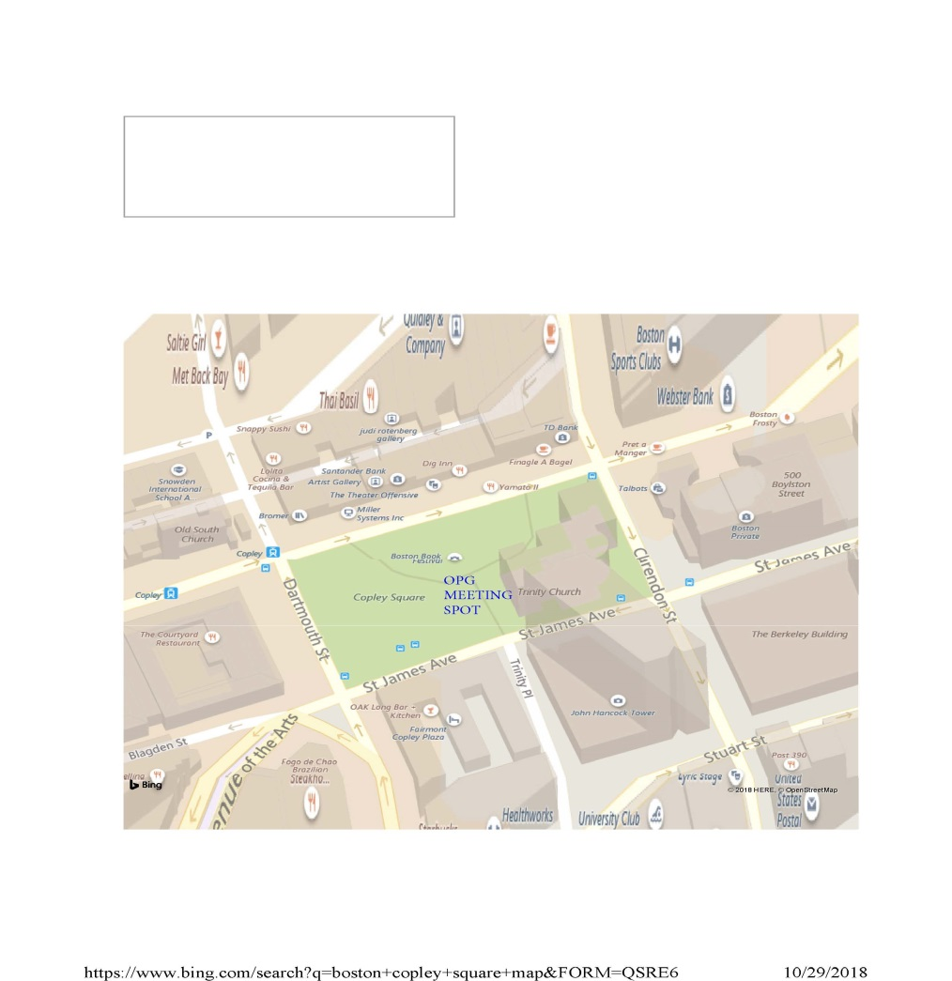
Why Shouldn’t I call Security or the Management Office?
Oxford and Security are dealing with the Boston Fire Department and the emergency itself. If necessary, they are preparing for the evacuation of floors.
Required information will be broadcast over the PA system or relayed to identified key tenant contacts through Send Word Now and/or in person at Trinity Church

Slide 46
Do I Inform Oxford the Floor is Evacuated?
The Fire Warden should report a successful floor/suite evacuation to the Oxford or Security representative at Trinity Church.
If a PRA is in position, the Fire Warden should inform security, Oxford representative, or an Emergency responder.

Slide 47
#7 -Next Steps

Slide 48
Next Steps
Establish an Emergency Response Team (ERT).
Train the ERT and become familiar with the building, exits and life safety systems.
Have all ERT members familiarize themselves with the Tenant Emergency Response Guide.
Develop or update an emergency telephone tree for contacting employees & customers.
Participate in evacuation drills.
Consider developing a business continuity/disaster plan.
Share a list of ERT members, PRAs, muster point and Send Word Now contact information with Oxford.

Slide 49
Q & A

Slide 50
Thank you.
222 Berkeley / 500 Boylston

