Slide 1
EMERGENCY RESPONSE FOR TENANTS
City View

Slide 2
Welcome to the City View Tenant Fire Warden Training Meeting.
The objective of this training is to provide you with essential emergency procedures and information to enhance your safety and security.
This training includes highlights of the buildings’ fire and life safety systems, emergency procedures that are relevant to the City of Austin, as well as other possible emergencies.

Slide 3
THE HARD FACTS…..
You cannot eliminate the possibility of a serious emergency.
You cannot predict when an emergency will occur.
You cannot afford to rely on automatic systems alone.
To react to an emergency effectively, people must be trained, equipped, and prepared.

Slide 4
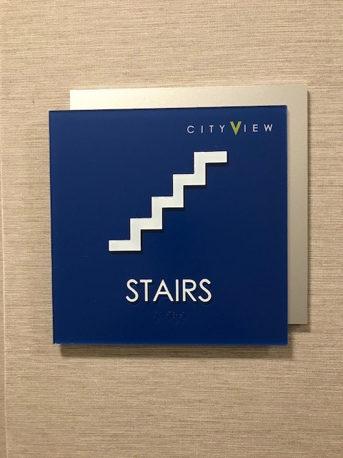
STAIRWELL LOCATIONS AND FEATURES
Each City View building has two stairwells that occupants can use in case of an emergency.

Slide 5
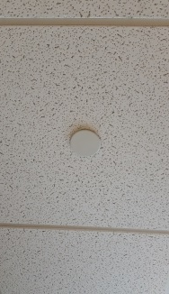
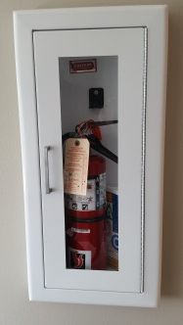
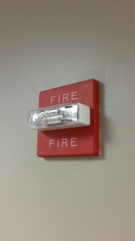
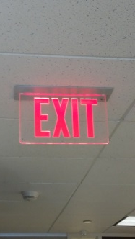
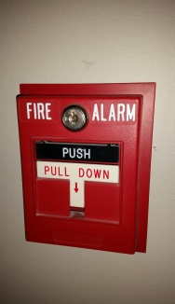
Fire and Life Safety Protection and Features
The buildings….
are fully sprinklered and have smoke/fire detectors throughout.
have pull stations located at all exit doors and all stairwells.
are supplied with fire extinguishers located at each stairwell, kitchen, and tenant spaces.
Each sprinkler head in your suite should be free and clear.

Slide 6

FIRE PREVENTION
Do not use space heaters or burn candles.
Do not overload extension cords or power strips.
Do not run electrical cords under rugs or mats.
Do not use any equipment that has a cracked or frayed power cord.
Do not smoke in any interior area of the building.
Do not extinguish cigarettes or cigars in any landscaped areas.
Do not leave appliances unattended while in operation.
For added safety….
X
Do not hang ornaments or decorations from sprinkler heads or strobes.
Do not stack items too close to the ceiling. There must be at least 18 inches below sprinklers to avoid blocking sensors.
Do not block exits or stairwells with boxes, furniture or other objects.

Slide 7
What to do: Fire Emergency
Activate the nearest manual pull station or fire alarm.
Clear the area quickly and calmly. Confine the fire by closing the doors as you evacuate in order to limit the spread of fire and smoke.
Before opening any closed doors, feel the back of the door with your hand. If hot, DO NOT OPEN.
Stay low to avoid any smoke or toxic fumes.
Evacuate to the nearest stairwell, and move to your company’s designated evacuation assembly area outside.
Call 911 and the management office at 737-237-1840
DO NOT USE THE ELEVATORS TO EVACUATE.
DO NOT EVACUATE TO THE ROOF.

Slide 8
What to expect when the alarm is activated.
When the alarm is activated, the strobe lights and speakers will sound on the floor the alarm activated. You may hear the alarm through the stairwells or elevator banks but unless you see the strobes flashing on your floor, you are not in the immediate area of concern.
The elevators will recall to the first floor, or the 3rd if the 1st floor is the area of alarm.
If it is deemed the entire building must evacuate, additional pull stations will be activated to set of the alarms on those floors.
REMEMBER…there are no false alarms! You do not need to wait for management to decide to evacuate your space. We will work as fast as possible to determine the cause and inform all tenants.

Slide 9
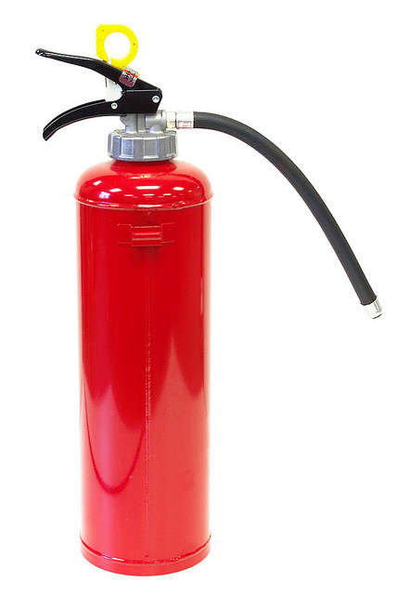
It is not recommended tenants try to fight a fire, but if it is small enough (not bigger than you), just remember…
P
PULL the pin.
A
AIM at the base of the fire.
S
SQUEEZE the top handle or lever to release the agent.
S
SWEEP from side to side.
You will only have about 15-20 seconds of use once you begin dispersing the extinguisher agent.

Slide 10
Fire Wardens/Assistant Fire Wardens-RESPONSIBILITIES
It is highly recommended that each tenant has at least one fire warden and one assistant fire warden. For multi-floor tenants, one per floor is recommended.
These volunteers are to participate in the annual fire warden meetings, be familiar with the evacuation procedures of the building and their own suite, know their company’s designated evacuation area, and assist their employees with safely evacuating the building.
They will also be the main point-of-contact between their company and management during the emergency.
An assistant fire warden will assist during emergencies or will fill in should the fire warden not be available during a time of emergency.
The fire warden/assistant fire warden will be responsible for notifying management or emergency personnel of any employees needing special assistance and can’t walk the stairs (e.g. employees in wheelchairs or on crutches, pregnant women, etc).
They will also let management/emergency personnel know of any employees not accounted for once in the designated evacuation area.

Slide 11
Good Evacuation Procedures
When instructed or the alarms have been activated on your floor, evacuate immediately.
Exit through the nearest stairwell in a single file, orderly manner. Do not push or run. Do not return for personal items.
Keep to the right in the stairwell to allow management or emergency personnel a clear path.
Remain calm and quiet so everyone can hear announcements and instructions.
Do not prop open the stairwell doors. This could cause smoke/fire to enter the stairwell, and impede the path for those evacuating.
For any employees needing special assistance and are not able to exit by the stairwell, place them in the stairwell vestibule, and let management/emergency personnel know immediately.
Evacuate to your company’s designated evacuation area. DO NOT block any building or garage entry point, or the driveways. These areas must remain clear for emergency personnel and vehicles.
Take note of any employees not accounted for in the evacuation area and let management/emergency personnel know if any employees are suspected of remaining in the building.
Stay out of the way of emergency vehicles and personnel, and wait for an ALL CLEAR before re-entering the building.

Slide 12
WHAT TO DO NEXT
Establish an evacuation team.
Train your evacuation team and become familiar with the building, exits, and designated evacuation area. Be familiar with how the building responds during emergencies.
Develop/update an emergency telephone tree for contacting employees and customers.
Participate in Fire Warden Meetings and the annual Fire Drill.
Consider developing an business disaster plan.

Slide 14
OTHER EMERGENCIES

Slide 15
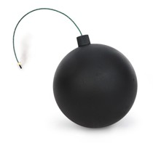
BOMB THREATS
When speaking to the caller, remain calm and try to obtain as much information as possible.
Listen carefully to the caller’s voice, odd words used, back ground noises….anything that can help authorities.
Keep the caller on the line as long as possible.
Ask questions such as where the bomb is located, when it is set to go off, what kind it was, how was it brought in the building.
Have a co-worker call 911, then the management office at 737-237-1840
Check your immediate area for anything suspicious. You are the best person to determine if something looks out of place.
DO NOT USE CELL PHONE OR TWO-WAY RADIOS.
Move to your designated evacuation area and do not leave the site. Emergency personnel may need your assistance in identifying any suspicious items.
Wait until you receive the “ALL CLEAR” before re-entering the building.

Slide 16

MEDICAL EMERGENCIES
Call 911.
Call the management office at
737-237-1840 so an elevator will be
available for emergency crews.
Do not move the injured or ill person.
Have someone meet the emergency crew
in the lobby.

Slide 17
ACTIVE SHOOTER
KEEP IN MIND: Most active shooter events are over in 10 minutes or less. In order to have the best chance of survival, you must remember the three basics of RUN, HIDE, FIGHT as advised by the Department of Homeland Security.
RUN: If there is an accessible escape path, attempt to evacuate the premises.
  Be sure to warn others not to enter
  Have an escape route in mind
  Evacuate regardless of others agree to follow or not
  Leave belongs behind
  Help others escape, if possible
  Keep your hands visible
  Follow instructions by the police
  Do not attempt to move injured people
  Call 911 when safe to do so

Slide 18
ACTIVE SHOOTER
HIDE: if safe evacuation is not possible, find a place to hide where the active shooter is less likely to find you.
Your hiding place should be…
  Be Out of the shooter’s view
  Provide protection if shots are fired in your direction
  Not trap you or restrict your options for movement.
You should….
  Lock the door and blockade it with heavy furniture, if possible
  Close, cover and move away from windows
  Silence your cell phone and/or pager – even vibration can give away your location
  Hide behind large items such as cabinets or desks
  Remain quiet

Slide 19
ACTIVE SHOOTER
FIGHT: As an absolute last resort, and only when your life is in imminent danger, attempt to disrupt and/or incapacitate the active shooter.
  Act as aggressively as possible against him/her
  Throw items and improvise weapons
  Yell
  Commit to your actions
  Following the above advice in no guarantee of safety, but it can increase your chances of survival.

Slide 20
SEVERE WEATHER
Remain calm.
Move away from windows.
Do not use the elevators.
Do not evacuate the building unless instructed.
Move to the stairwells or restrooms as they are the safest areas of the building.
If trapped in an office, seek shelter under a desk.

Slide 21

FLOODING/LEAKS
Notify the management office at
737-237-1840
Unplug all electrical equipment in the area
All equipment not unplugged should be treated as an electrocution threat.
DO NOT use any electrical or office equipment that has come in contact with water.

Slide 22

POWER FAILURE
Notify the management office at
737-237-1840
Open all blinds to allow more light for safety.
Unplug office machines that may be affected by a power surge.
Do not use candles…use flashlights only.
If you decide to evacuate, do so safely through the stairwells.
Management will contact you with any updates from the City.

Slide 23

ELEVATOR ENTRAPMENT
Remain calm.
Push the “ALARM” button on the elevator panel.
Open the door marked “PHONE” and press the button. You will be connected with the monitoring company who will assist you.
DO NOT try to force open the doors.
DO NOT attempt to evacuate the elevator through the ceiling.
DO NOT attempt to evacuate the elevator if it is not level with your floor.
Relax and know that every effort is being made to release you as soon as possible.

Slide 24

SUSPICIOUS PACKAGES
Place the suspicious envelope/package in a plastic bag, preferably one with a seal, or place in a trash can and cover.
Once sealed or covered, do not move.
If powder from the object was spilled, do not attempt to clean it up.
If powder from the object got on clothing, remove the clothing and place in sealed bag.
Evacuate the room and close the door.
Wash your hands with soap and water, or any other areas that were in contact with the package.
Call 911 and the management office at 737-237-1840

Slide 25
QUESTIONS?
Thank you for attending the Fire Warden Meeting for
City View

